Slide 1
Taking the Next Steps
Informing a RoadMap for Aboriginal health research in South Australia
2024
Odette Pearson, Kim Morey, Karen Glover, Michael Larkin, Leda Sivak, Naomi Thornthwaite, Gokhan Ayturk, Alex Brown, Shane Mohor

Slide 2
The Australian Institute of Aboriginal and Torres Strait Islander Studies acknowledges the traditional owners of country throughout Australia and their continuing connection to land, culture and community. We pay our respects to elders past and present.
The authors acknowledge Kaurna ancestors and elders, as the research for this work largely took place on the traditional lands of the Kaurna people. We pay our respects to elders past and present.
aiatsis.gov.au

Slide 3
Introduction
From July 2022 to June 2024
The Aboriginal Health Council of South Australia (AHCSA) and Wardliparingga Aboriginal Health Equity research team (Wardliparingga) at the South Australian Health and Medical Research Institute (SAHMRI) completed the Taking the Next Steps project, funded by the AIATSIS Indigenous Research Exchange.
Its purpose was to…
To assess the capability and identify the capacity development needs of the Aboriginal health and medical research sector in South Australia to respond to Aboriginal-informed research priorities and ways to conduct research.

Slide 4
Background: Building on Next Steps and the Accord
Next Steps project (King & Brown, 2015)
Identified research priorities for South Australia
South Australian Aboriginal Health Research Accord (Wardliparingga, 2014)
Identified nine principles for conducting Aboriginal health research

Slide 5
Study Objectives
TO build capacity of the health and medical research sector in conducting research effectively with Aboriginal research collaborators, participants and beneficiaries
BY developing a co-informed RoadMap that provides direction on the areas of focus to strengthen the sector’s ability to respond to Aboriginal priorities and apply Aboriginal principles for conducting research

Slide 6
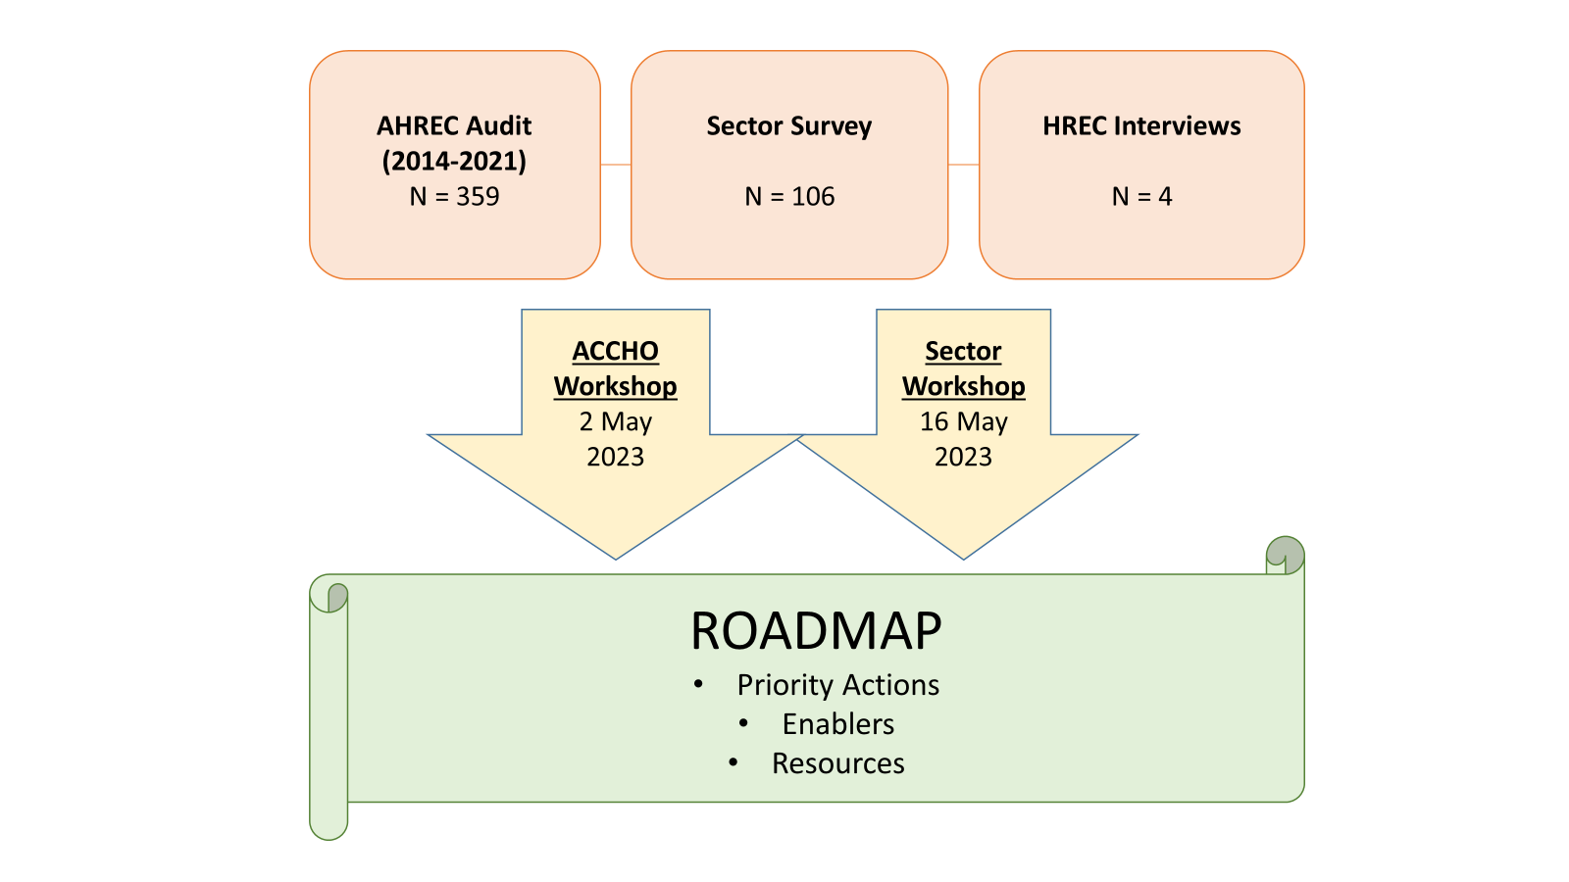
Methods

Slide 7
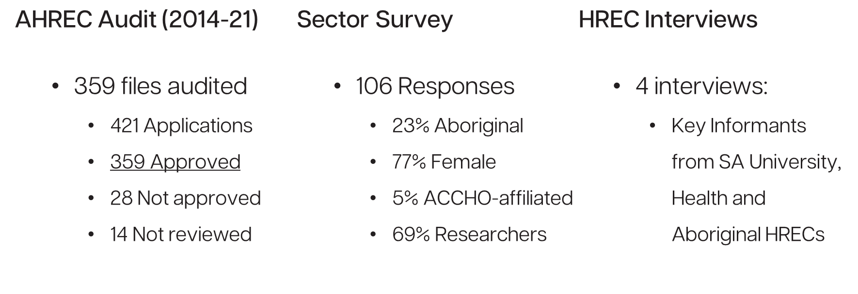
Summary of Key Findings: Audit, Survey, Interviews

Slide 8
Key Findings
Audit of Applications to the South Australian Aboriginal Health Research Ethics Committee (AHREC), 2014-2021

Slide 9
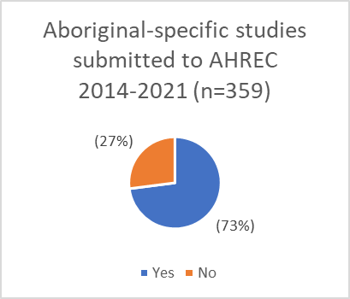
Findings: Audit Proportion of Aboriginal-specific studies

Slide 10
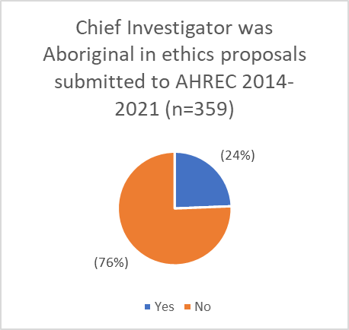
Findings: Audit Chief Investigator ethnicity

Slide 11
Findings: Audit Consultation with Aboriginal communities

Slide 12
Key Findings
Survey of Aboriginal health research sector in South Australia – 6 December 2022 to 20 January 2023 (n=106)

Slide 13
Survey respondent characteristics (n = 106)

Slide 14
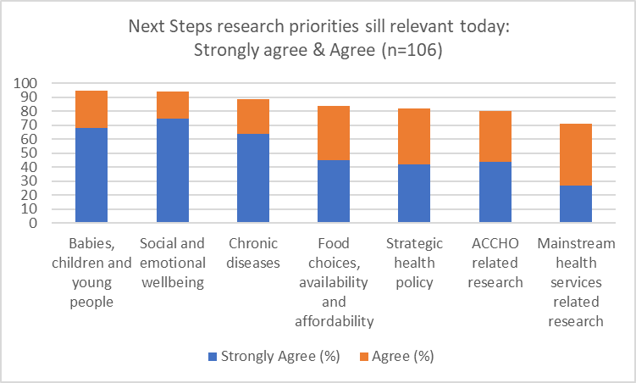
Findings: Survey South Australian research priorities – still relevant now?

Slide 15
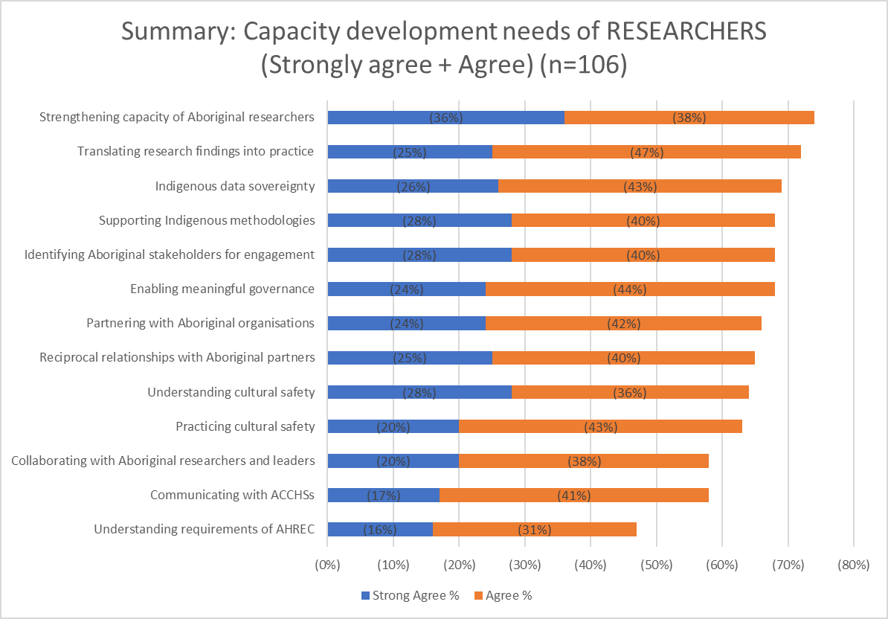
Findings: Survey Capacity development needs of RESEARCHERS

Slide 16
Findings: Survey Capacity development needs of research SECTOR

Slide 17
Key Findings
Interviews with Chairs of Human Research Ethics Committees (HRECs) in South Australia – March 2023

Slide 18
Findings: Interviews (1 of 2)
Interview Findings | Key Learnings
1. Role and value of Aboriginal-specific HRECs | Three key strengths characterise the value of Aboriginal-specific HRECs: research and cultural expertise; connection to community; and research quality. Key challenges for Aboriginal-specific HRECs include issues of impartiality and risks of over-reliance on these HRECs by mainstream HREC members.
2. Familiarity with and use of Aboriginal-specific research guidelines, codes and principles | South Australian HREC members are familiar with and use the NHMRC Guidelines and AIATSIS Code of Ethics regularly. There is intermittent familiarity with the South Australian Health and Medical Research Accord, with familiarity especially limited in the university sector.
3. Common issues in Aboriginal-specific research proposals | Common issues that South Australian HRECs encounter when reviewing Aboriginal-specific research proposals include: research priorities; intellectual property; community engagement; research relationships; risk management; and community feedback and knowledge translation. Most of these issues are addressed in the Accord.

Slide 19
Findings: Interviews (2 of 2)
Interview Findings | Key Learnings
4. Improvements in research proposals within the past five years | HREC members identified the following improvements to Aboriginal-specific research proposals within the past five years: cultural sensitivity of mainstream HRECs; improved Aboriginal engagement and involvement in research; increased use of Indigenous research methods and methodologies; and improved community feedback and knowledge translation.
5. Areas for further improvement | Areas where further improvement is needed in the preparation of Aboriginal-specific research proposals include: addressing specific contexts of research; ethics committee processes; and the need for a state-wide Aboriginal health research community forum.

Slide 20
Methods & Findings
Workshop with South Australian Aboriginal Community Controlled Health Organisations (ACCHOs) – 2 May 2023 (n=4 participants)

Slide 21
Methods: ACCHO Workshop
SWOT | GUIDING QUESTIONS
Strengths | What value do ACCHOs bring to research? What are the internal factors that contribute to ACCHOs leading research and being partners in health research?
Weaknesses | What are the internal capacity challenges for ACCHOs? What are the gaps in research or where do ACCHOs lack confidence undertaking research?
Opportunities | How could researchers better improve the way they undertake research or engage with services? How do we turn the identified strengths into opportunities?
Threats | What are the external factors that get in the way of meaningful research? What have been your experiences with researchers and research?

Slide 22
Findings: ACCHO Workshop (1 of 2)
SWOT | Key Learnings
Strengths | ACCHO involvement in health research supports culturally safe research settings and holistic approaches to working with Aboriginal communities. ACCHOs provide community and health service context for research projects. ACCHOs support community members to participate in and drive research that affects them. ACCHOs support research translation by ensuring Aboriginal communities have community control and understanding of the research from the beginning. ACCHOs support community-appropriate language within research activities.
Weaknesses | Lack of resources, including dedicated funding and dedicated research staff, inhibit ACCHOs from participating in research. ACCHOs struggle to win competitive funding independently. Research with remote communities faces challenges with sample size that could benefit from regional/remote ACCHOs joining together to share resources, funding and participant numbers. ACCHOs expressed concern about external researchers and emphasised the need to build trust between researchers, ACCHOs and participating communities.

Slide 23
Findings: ACCHO Workshop (2 of 2)
SWOT | Key Learnings
Opportunities | ACCHOs see opportunities for strengthening the cultural safety of research environments and methods through their involvement in research. Involving ACCHO representatives as investigators on research projects will strengthen community-based research. Early engagement with and input from ACCHOs, while researchers are preparing ethics submissions, can strengthen the community-appropriateness of research materials and processes. Involvement of Aboriginal researchers and non-Indigenous researchers who have strong connections with communities can strengthen research. Attending to the diversity of Aboriginal communities can strengthen research. Creative workforce opportunities, such as combining clinical contributions and clinical research, could strengthen research.
Threats | Financial, resource and workforce challenges represent threats to ACCHO involvement in Aboriginal health research. Considerations of Indigenous data sovereignty need to be negotiated with ACCHOs and researchers. Communication infrastructure, such as high-speed internet connections, need to be taken into account when working with regional and remote ACCHOs.

Slide 24
Methods & Findings
Workshop with South Australian Aboriginal health research sector – 16 May 2023 (n = 35 participants)

Slide 25
Methods: Sector Workshop
Roundtable theme | Prompt statements (to reflect on enablers, barriers and actions to address these barriers and enablers)
Priorities, partnership, cultural knowledge | All research projects I have been involved in were conducted on a priority identified by an Aboriginal community. I have a good understanding of what is expected of me in terms of cultural safety. All research projects I have been involved in were established on mutual trust and equal partnerships w/ Aboriginal community. I am aware that there is public and private cultural knowledge.
Engagement, involvement | I have knowledge and experience in respectfully engaging Aboriginal organisations and communities in research. All research projects I have been involved in ensured that Aboriginal people and organisations were an integral part of developing, implementing and translating research. I have partnered with Aboriginal researchers. Aboriginal researchers have been employed in research projects that I have worked on.
Intellectual property, Aboriginal ownership, tangible benefit | All research projects I have been involved in led to tangible benefits for Aboriginal communities. All research projects I have been involved in transparently negotiated intellectual property use and Aboriginal ownership. All research projects I have been involved in acknowledged Aboriginal intellectual property rights.
Community feedback and knowledge translation | The study I was involved in purposefully translated the research findings. The research I was involved in had a tangible knowledge translation strategy. The research findings were presented to partnering organisations and communities. The research team utilised study findings to advocate for policy change.
Indigenous research methodologies and research materials | I understand the cultural considerations regarding biological samples. All research projects I have been involved in ensured respectful and culturally appropriate management of all biological and non-biological research materials. I am aware of Indigenous research methodologies. I am aware of the need for Aboriginal leadership, oversight and participation in the use of Indigenous methodologies.

Slide 26
Findings: Sector Workshop (1 of 3)
Roundtable | Key Learnings
1. Priorities, partnership, cultural knowledge | ENABLERS: Aboriginal research leadership; Aboriginal-led research priorities, accountability and knowledge translation; co-design processes that engage community input; community involvement in research; and accommodation of community diversity. BARRIERS: budgets; timelines; lack of Aboriginal chief investigators; lack of an Aboriginal research body; challenges of distinguishing between public and private knowledge; and limitations of preconceived ideas guiding research outcomes.
2. Engagement, involvement | ENABLERS: Aboriginal researchers; Aboriginal community leadership and recognition of Aboriginal cultural authority; lived experience; long-term partnerships; community ownership; co-design; meaningful research involvement for Aboriginal communities; appropriate partner organisations; community research ambassadors; partnerships with services including ACCHO; investing in young peoples; developing a register of Aboriginal health research in South Australia. BARRIERS: burdens on ACCHO sector to participating in research; AHREC capacity for monitoring and accountability; limitations in Aboriginal community capacity; identification of appropriate partner organisations; Aboriginal staff recognition in communities; community fatigue; and research reciprocity.

Slide 27
Findings: Sector Workshop (2 of 3)
Roundtable | Key Learnings
3. Intellectual property, Aboriginal ownership, tangible benefit | ENABLERS: Aboriginal leadership; establishing intellectual property agreements at the beginning of research projects; Aboriginal ownership and control of research processes and data; involving Aboriginal people at all stages of research including analysis and authorship; [they proposed] data management guidelines; return of intellectual property to advisory groups and relevant others; transparency in referencing community input; and including advisory group members on grants and publications. BARRIERS: financial constraints in grant structures; overstretched Aboriginal researchers; lack of clarity regarding public and private knowledge; navigating co-ownership and true ACIP; authorship criteria that acknowledge Aboriginal participation; and limited community research capacity.
4. Community feedback and knowledge translation | ENABLERS: designing research translation activities at the start of projects; including all stakeholders when designing research translation; considering potential impact at the beginning of projects; communicating research findings and outcomes to participating communities; professional development regarding knowledge translation; embedding Aboriginal health workforce in the design of translation. BARRIERS: timeframe pressures from funding bodies; time taken to translate findings into policy and practice; ensuring appropriate language; accountability; and meaningful translation and communication.

Slide 28
Findings: Sector Workshop (3 of 3)
Roundtable | Key Learnings
5. Indigenous research methodologies and research materials | ENABLERS: Indigenous researcher authority; building legitimacy of Indigenous methodologies; Aboriginal people with lived experience informing methods; Aboriginal community input into appropriate management of biological and non-biological materials. BARRIERS: time constraints; lack of structured learning and development regarding Indigenous methodologies; community expectations regarding management of research materials; historical practice and ongoing mistrust; inconsistent messaging about good data processes, including policies and frameworks to support these; and fatigue.

Slide 29
Conclusions
These findings from the Taking the Next Steps project will be used to inform a RoadMap for the Aboriginal health research and medical research sector in South Australia.
The RoadMap will seek not only to summarise what is already happening – by drawing on the results of the audit, survey, interviews and workshops – but also to identify:
Areas of focus to build capacity of the health and medical research sector in conducting research with Aboriginal communities in South Australia
Suggested actions that will contribute to achieving this
Who needs to be involved to embed and support these actions
It is envisioned that the RoadMap will provide strategic guidance to implementing the South Australian Health and Medical Research Strategy from an Aboriginal research perspective, as well as tangible actions that organisations and researchers can achieve.
An informed and capable health and medical research sector in the effective conduct of Aboriginal Health Research will result in the South Australian Aboriginal community experiencing greater benefits from research.

Slide 30
This research was funded by AIATSIS Indigenous Research Exchange (EO278-20210721).

