Slide 1
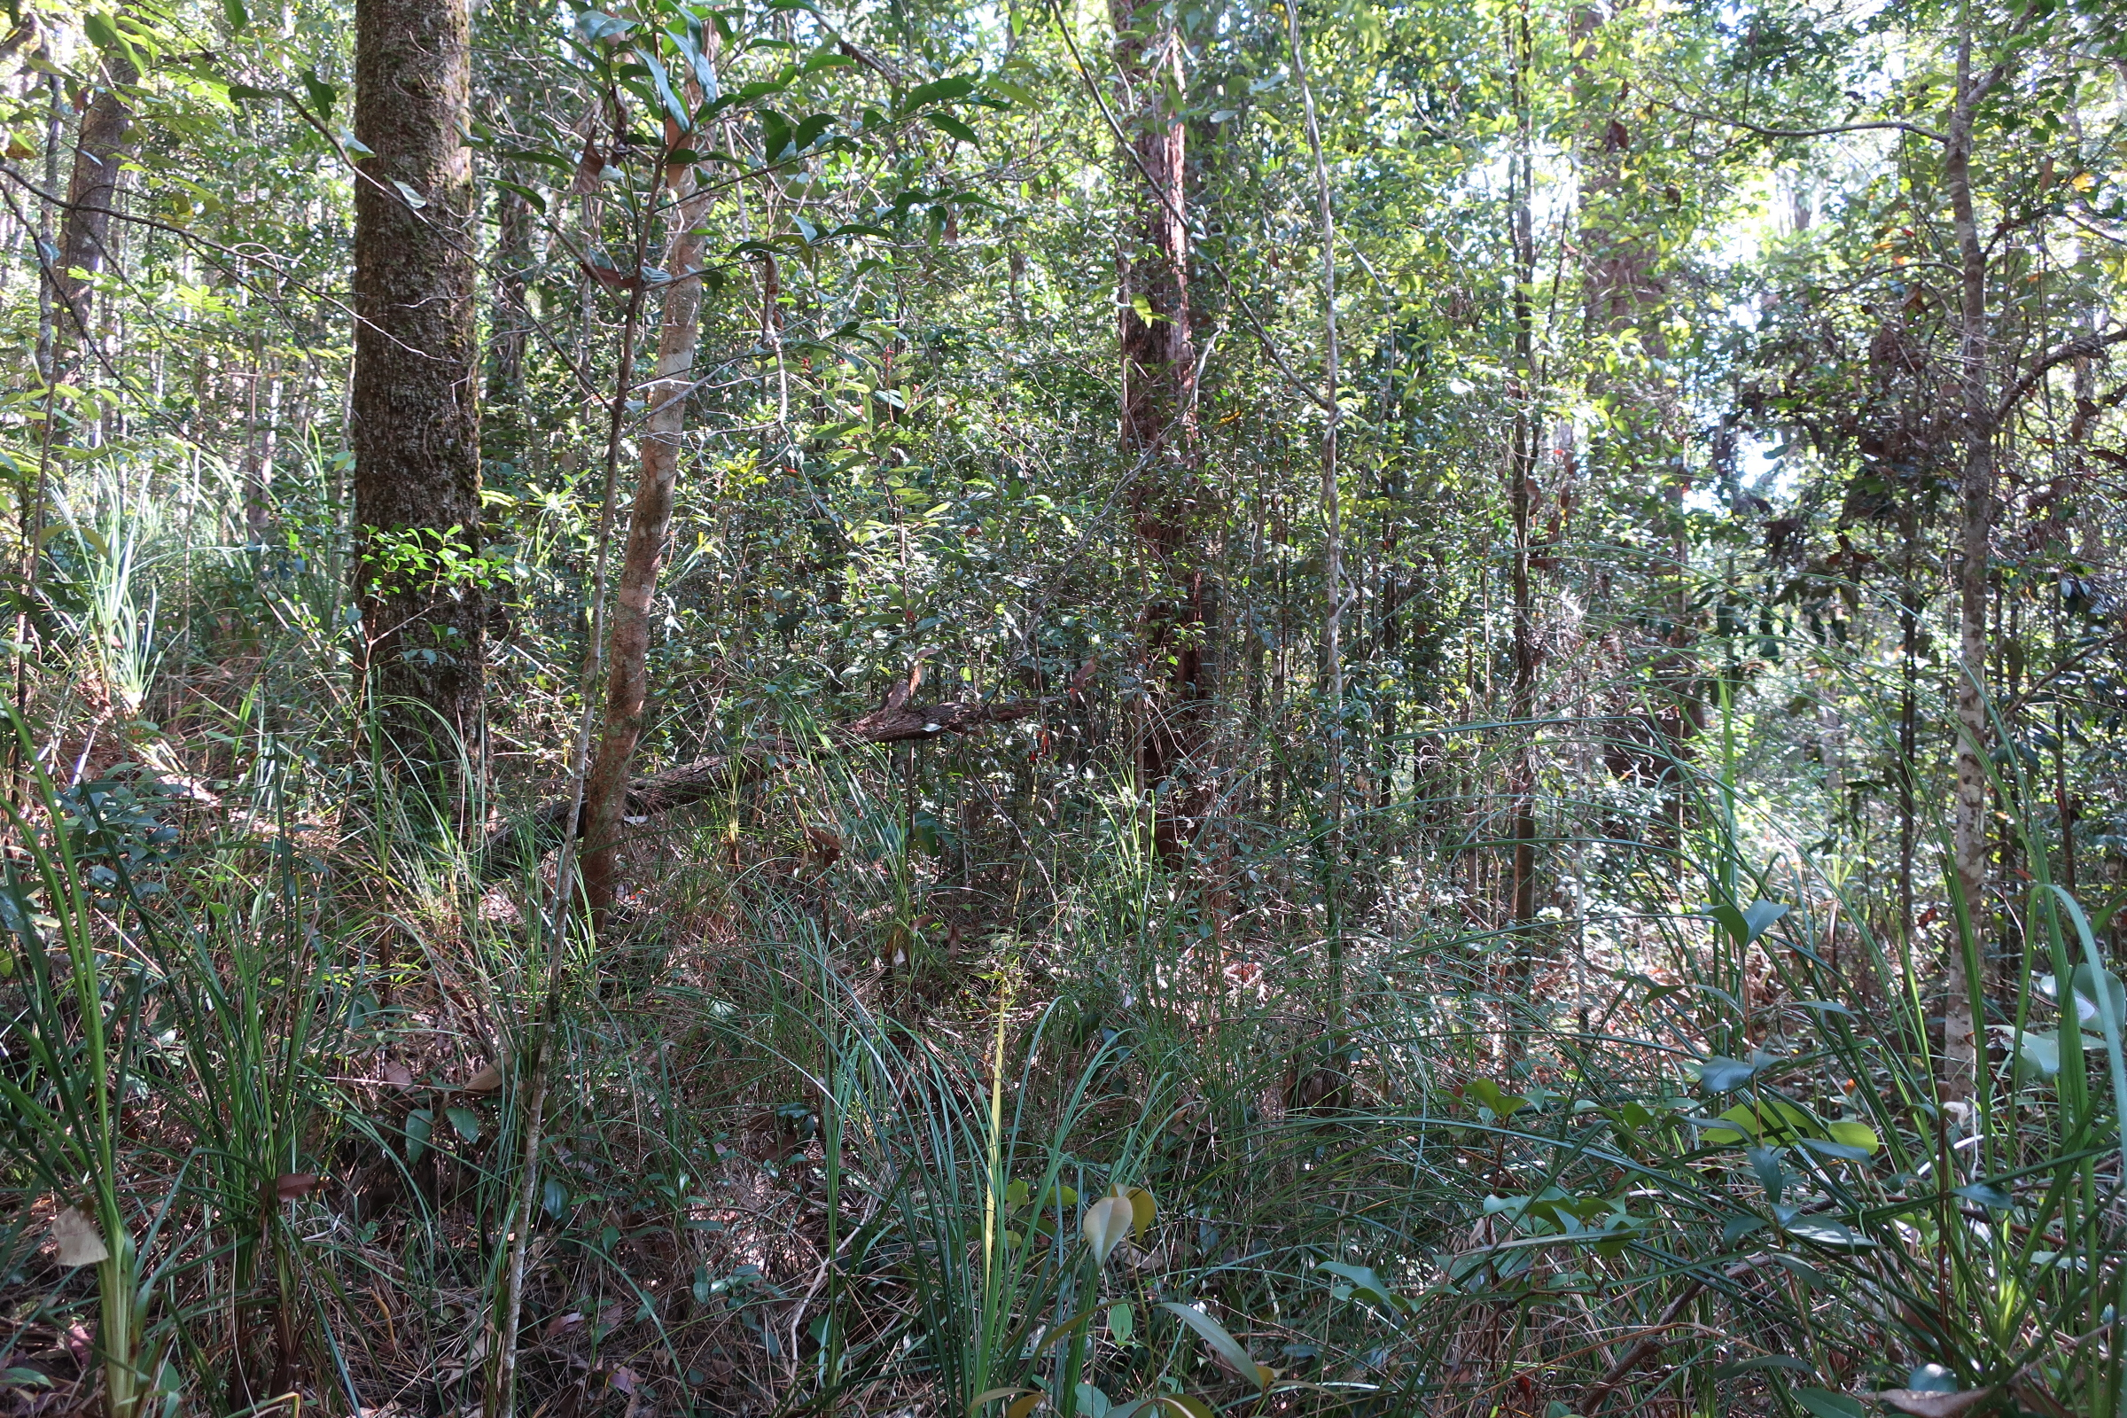
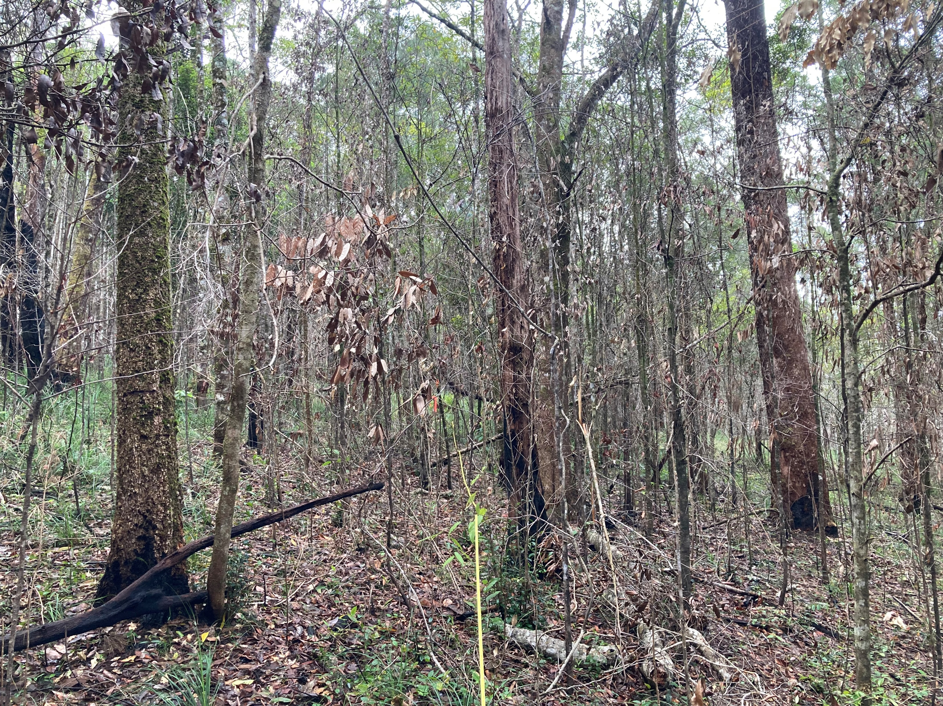
URUMBAL 1
START 2019
FIRE NOV’ 2022
START 2023

Slide 2
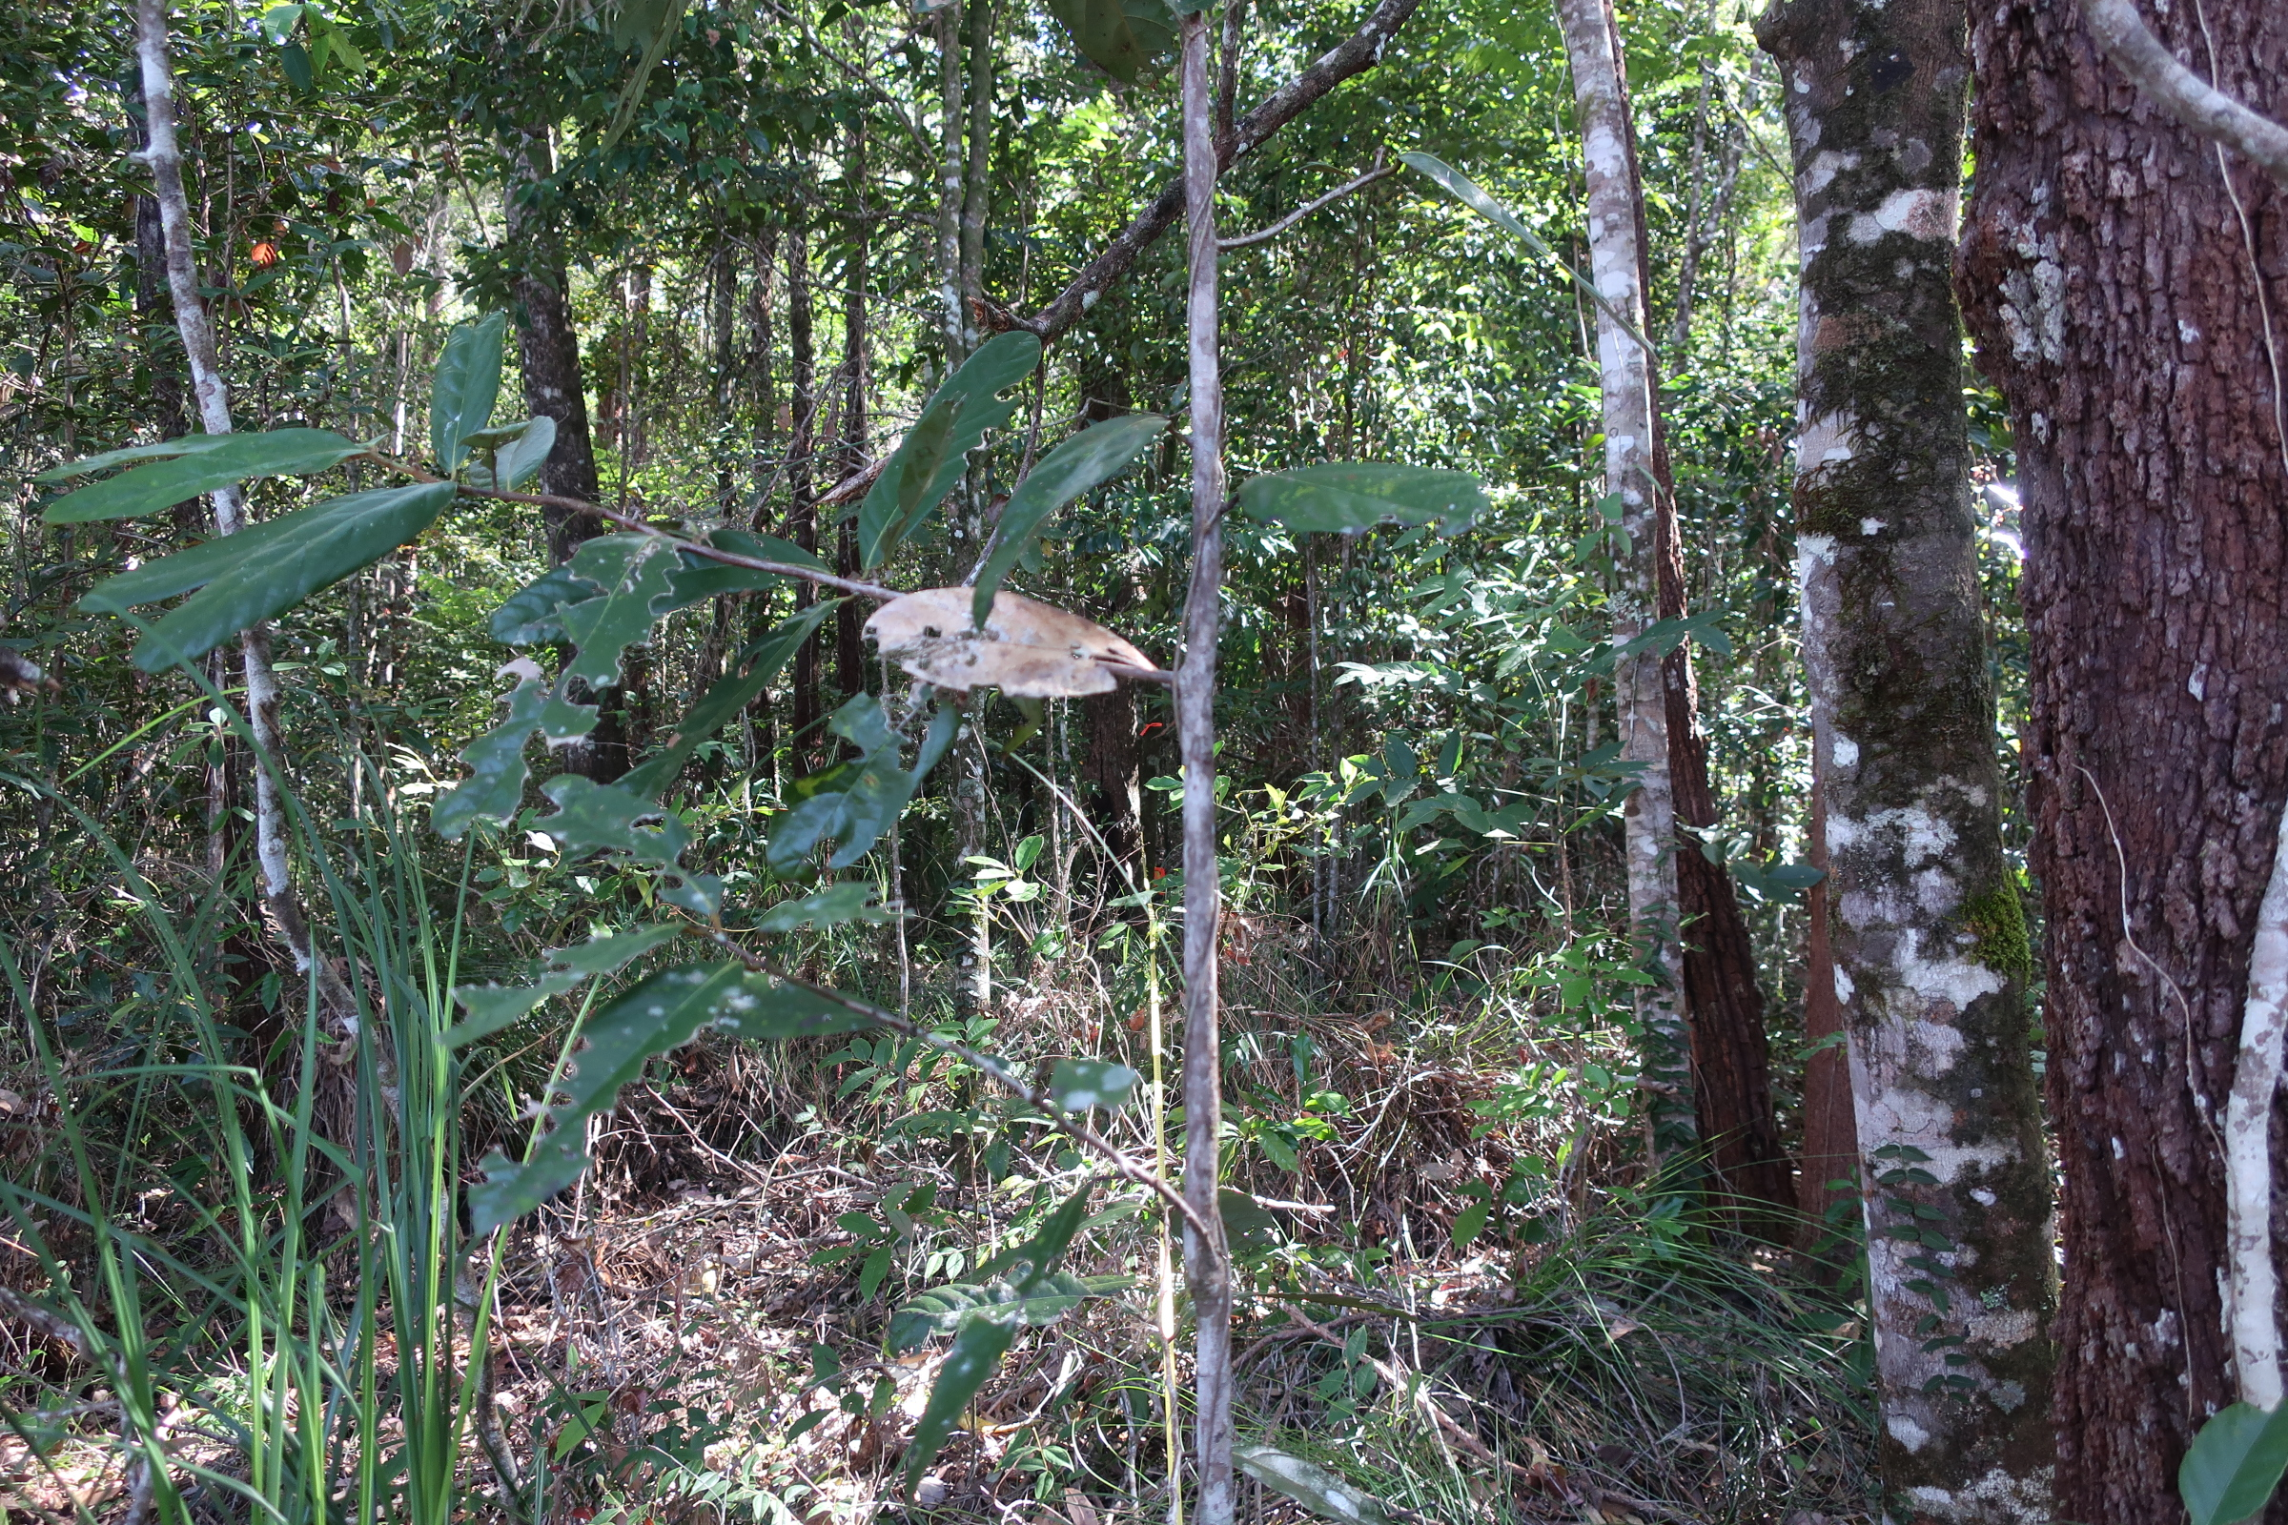
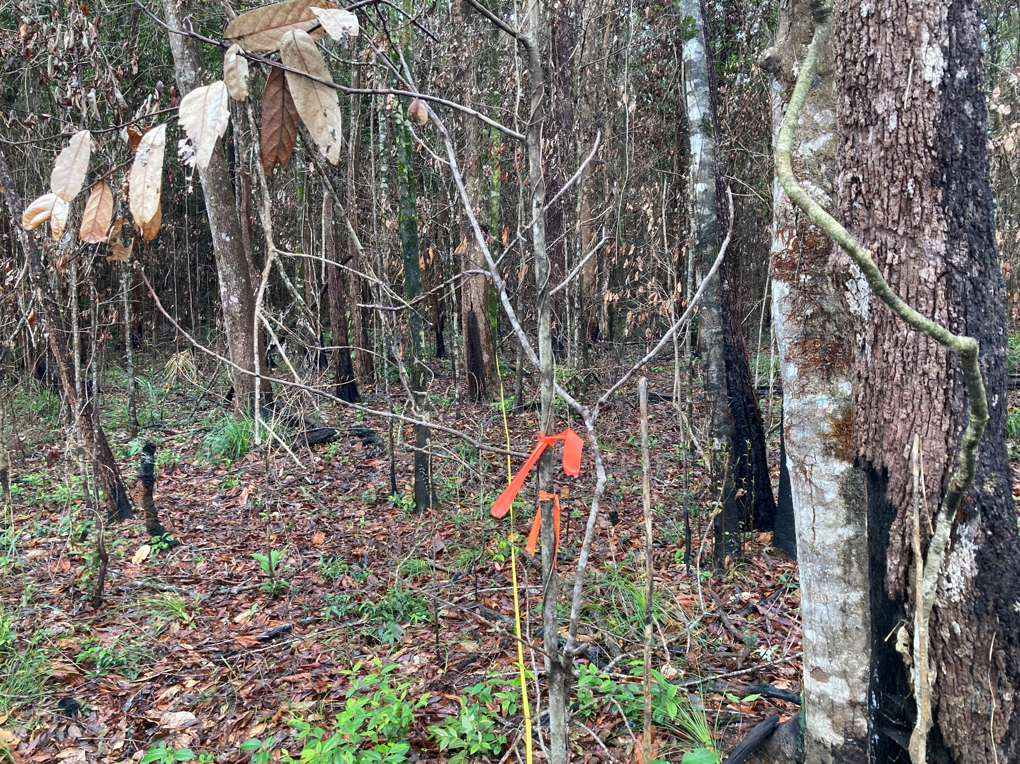
URUMBAL 2
START 2019
FIRE NOV’ 2022
START 2023

Slide 3
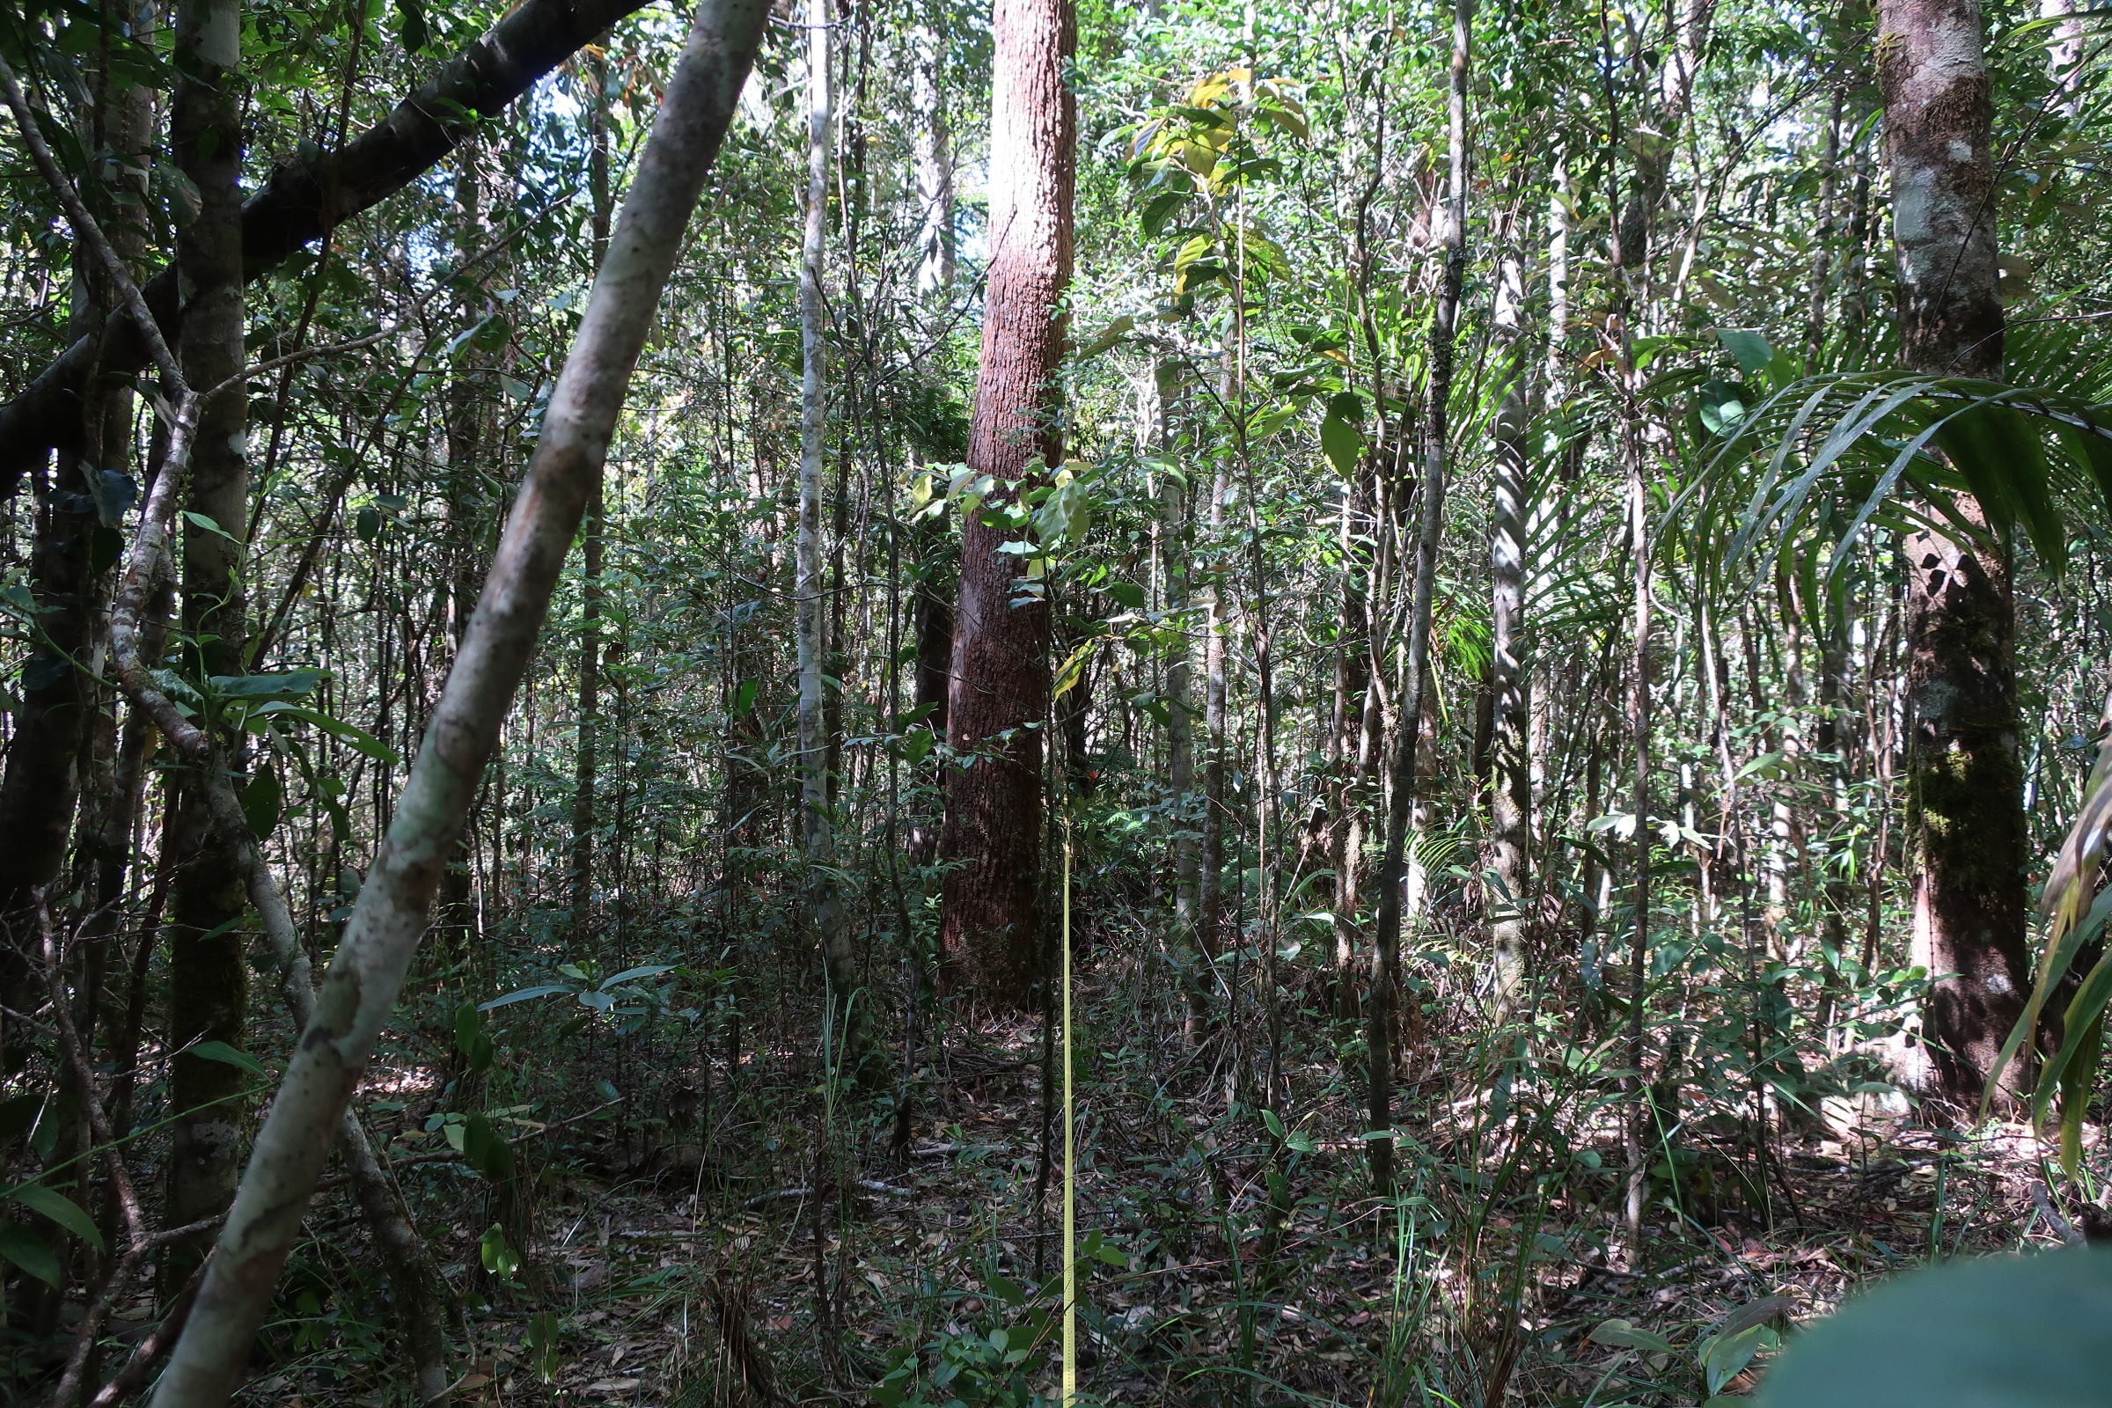
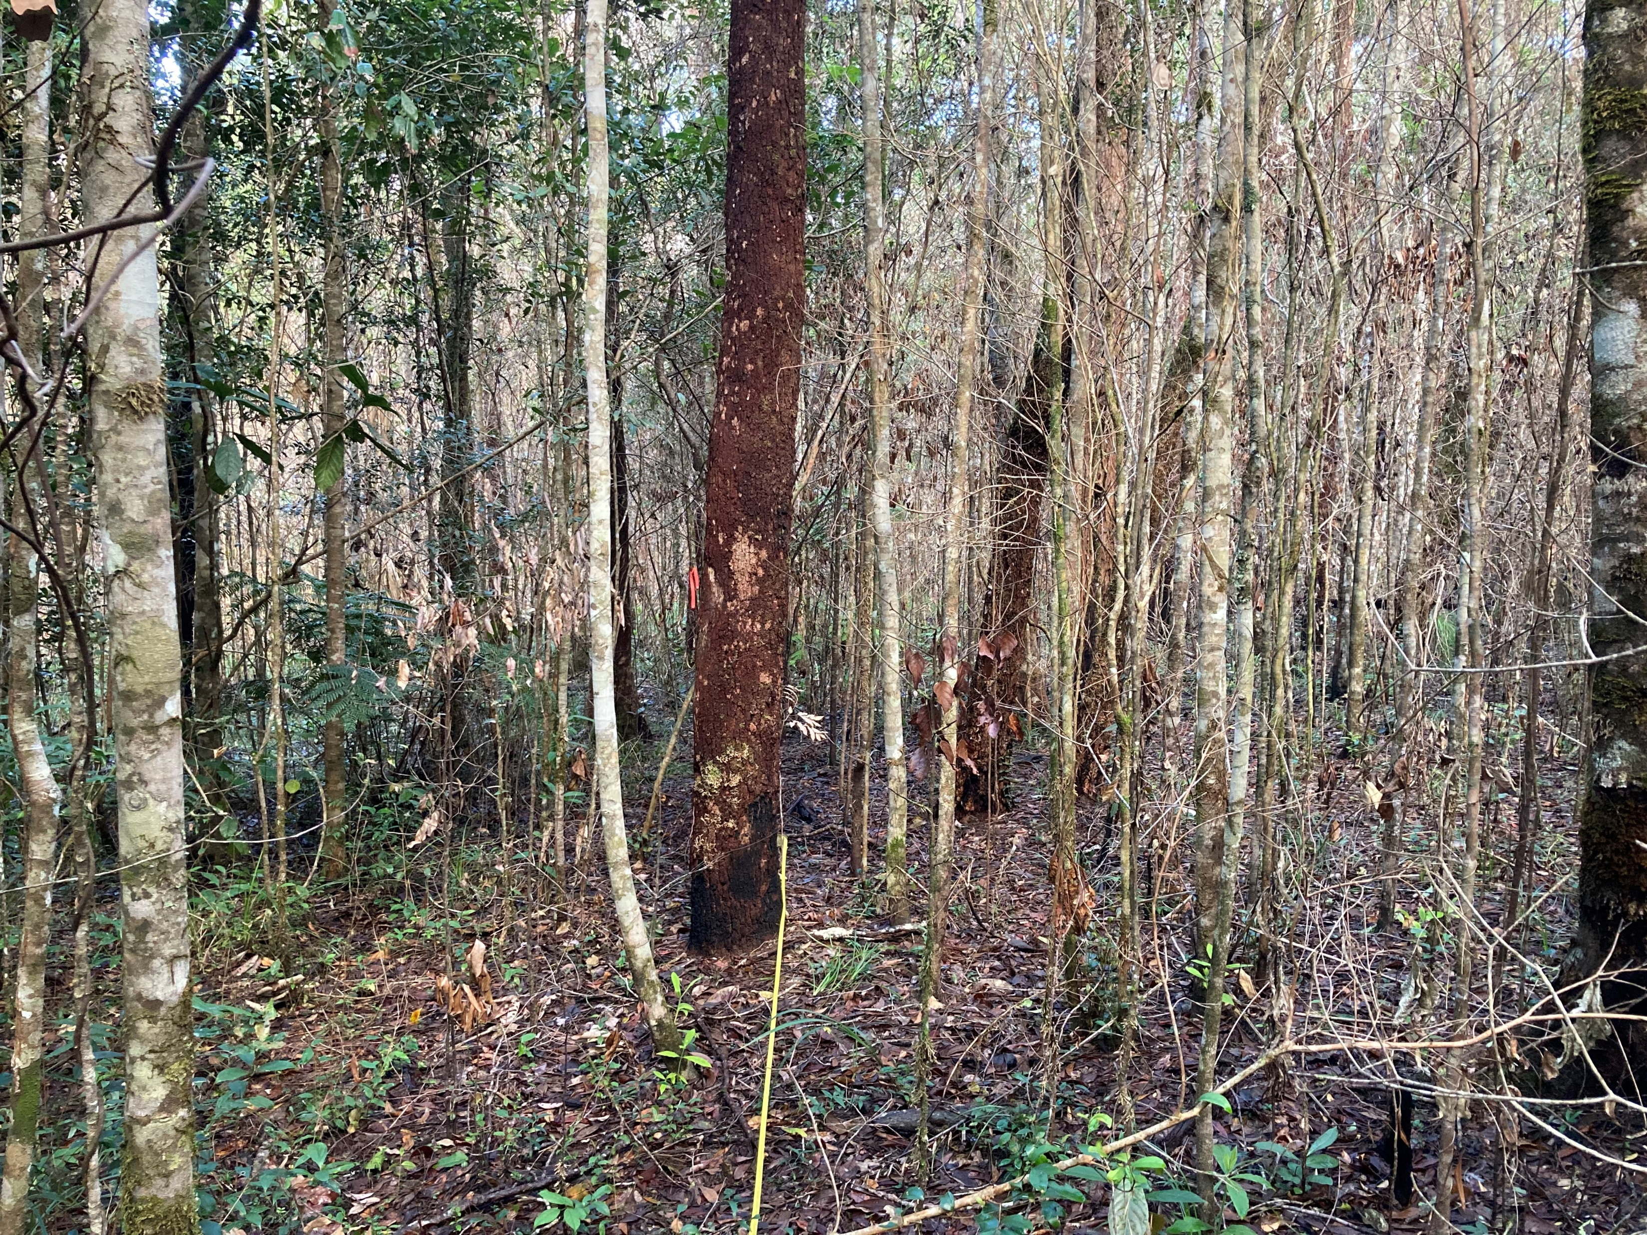
URUMBAL 3
START 2019
FIRE NOV’ 2022
START 2023

